Slide 1
Improving Model Stability and Training Efficiency
in Fast, High Quality Expressive Voice Conversion System
Zhiyuan Zhao, Jingjun Liang, Zehong Zheng, Linhuang Yan
Zhiyong Yang, Wan Ding, Dongyan Huang
Notes:
首页

Slide 2
Contents
Background & Objectives
Methods & Experiments
Applications
Future Work

Slide 3
Background & Objectives
High Quality and Stability
Parrotron (∼30,000 hour training set)
VCC2020 1st place: ASR-TTS (using iFLYTEK ASR engine)
High Efficiency
Expectation: Larger Dataset & Shorter Training / Inference Time
Expressive Speech Synthesis
Applications: Dubbing, Audiobooks, Emotional Interaction, etc.
Biadsy, Fadi, et al. "Parrotron: An end-to-end speech-to-speech conversion model and its applications to hearing-impaired speech and speech separation." arXiv preprint arXiv:1904.04169 (2019).
Liu, Li-Juan, et al. "Non-Parallel Voice Conversion with Autoregressive Conversion Model and
Duration Adjustment." Proc. Joint Workshop for the Blizzard Challenge and Voice Conversion Challenge 2020.

Slide 4
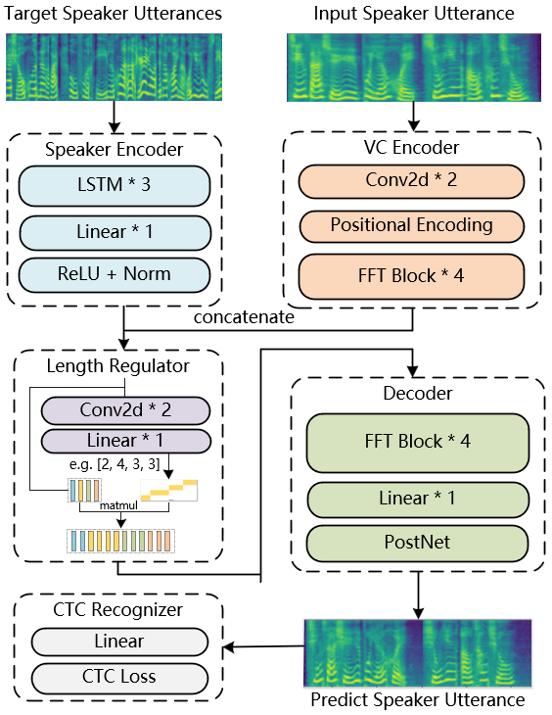
High Quality & Inference Efficiency
Fastspeech based non-autoregressive model
Tacotron based autoregressive model

Slide 5
High Quality and Stability
One-to-Many Training Strategy
Construct parallel data pairs from multi-speaker
dataset covering more words
CTC(connectionist temporal classification) Recognizer
Higher stability of synthesized audios

Slide 6
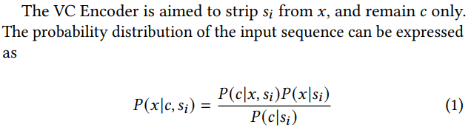
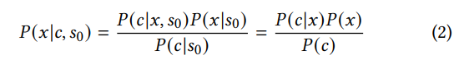

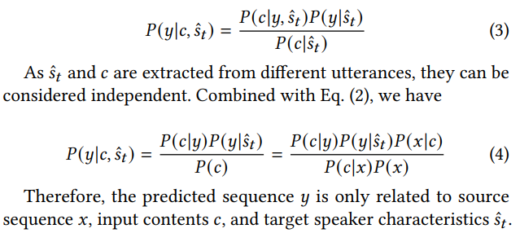
High Quality and Stability (One-to-Many Training Strategy)

Slide 7

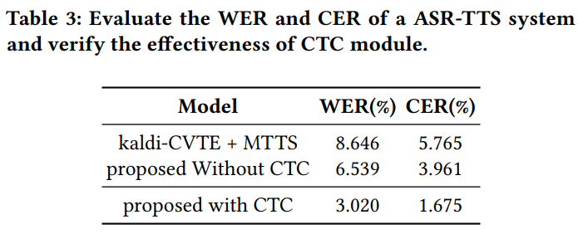
High Quality and Stability (CTC Recognizer)
With CTC
躺 椅 不 错, 适 合 卧 着 阅 读, 是 不 是 靠 植 物 太 近 了。(√)
Tǎng yǐ bù cuò, shì hé wò zhe yuè dú, shì bú shì kào zhí wù tài jìn le.
Without CTC
躺 椅 不 错, 适 合 卧 着 阅 读, 是 不 是 靠 植 物 太 近 了。
Tǎng yǐ bù cuò, shì hé wò zhe yuè dú, shì bú shì kào zhí wù tài jìn le.
Baseline
躺 椅 不 错, 适 合 卧 着 阅 读, 是 不 是 靠 植 物 太 近 了。
Tǎng yǐ bù cuò, shì hé wò zhe yuè dú, shì bú shì kào zhí wù tài jìn le.

Slide 8
Training Efficiency
Previous Research
“Model stability does not seem to be directly linked to amount of training data. Stability depends on the characteristics of the data itself, but we could not find any clear pattern for it.”[1]
Our Proposed
Model stability is related to the richness of the vocabulary of training data.
[1] Javier Latorre, Jakub Lachowicz, Jaime Lorenzo-Trueba, Thomas Merritt, Thomas Drugman,
Srikanth Ronanki, and Klimkov Viacheslav. 2018. Effect of data reduction on sequence-to-sequence neural TTS.

Slide 9
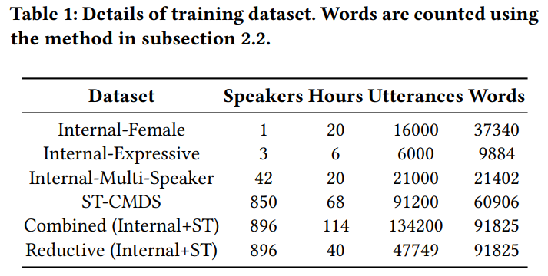
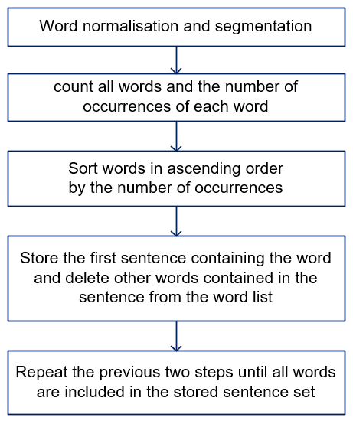
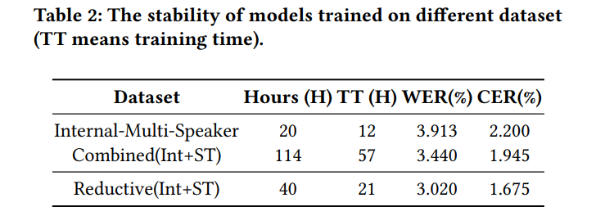
Training Efficiency
Method
Experiment

Slide 10
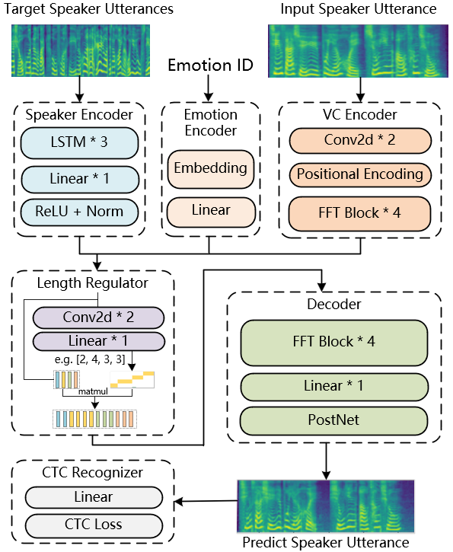
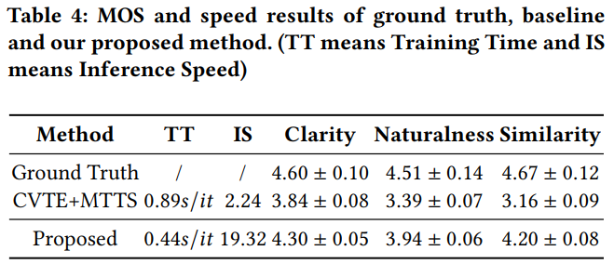
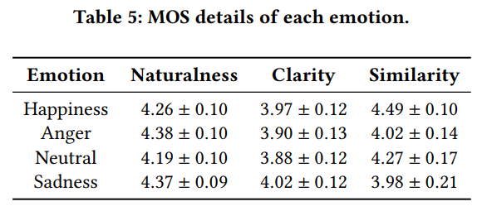
Expressive Speech Synthesis

Slide 11
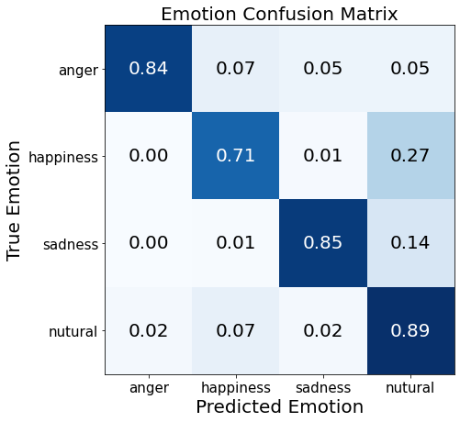
Expressive Speech Synthesis
心 动 不 如 行 动，我 不 太 擅 长 卖 萌。
Xīn dòng bù rú xíng dòng, wǒ bù tài shàn cháng mài méng。
Target Emotion
Proposed
Baseline
Neutral
Happiness
Anger
Sadness

Slide 12
Applications
Few-shot Cross Lingual Voice Conversion（5min）
Source Speaker：(female zh)
Synthesised Audio：
(female en)
Content：
(TTS en)
Source Speaker：
(male zh)
Synthesised Audio：
(female en)
Fine-grained Prosody Control（5min）
Source (neutral) ：
Source (expressive)：
Synthesised：
(Lv0)
Synthesised：
(Lv1)
Synthesised：
(Lv2)
Notes:
空白页

Slide 13
Future Work
Diverse intonational prominent
Robust and fine-grained prosody control
Multi-lingual / cross-lingual speech synthesis

Slide 14
Thank You!
Notes:
空白页

